Slide 1


Bank Loan Data Set(Case Study)
Name - Mritunjay Kumar
Date – 14th April 2023

Slide 2
Agenda
1
Objective & Use Case & Dataset Description followed by Expectation
2
Data Analysis – Using Pandas-Profiling
3
Architecture Design (End-to-End)
4
Data Processing – Data Cleaning and Feature Engineering
5
Visualization
6
EDA Insights
7
Modeling and Comparisons

Slide 3
Objective & Use Case & Dataset Description followed by Expectation
A
Objective
Using the Data set, help to build a Machine Learning Model which can predict if a Customer would take up Personal Loan if the targeted Marketing Campaign is done.
B
Use Case
The bank wants to explore ways of converting its liability customers to personal loan customers (while retaining them as depositors). A campaign that the bank ran last year for liability customers showed a conversion rate of over 9% success. This has encouraged the retail marketing department to devise campaigns with better target marketing to increase the success ratio with minimal budget.
C
Dataset Description
Data set Description:
Variable Name | Description
ID | Customer ID
Age | Customer Age(Years)
Experience | Professional Experience(Years)
Income | Annual Income ($1000)
Postal Code | Postal Code of the Customer Home Address
Family Size | Family Size of the Customer
CCAvgSpending | Credit Card Avg Spending per Month($1000)
Education | Customer Education Level(Undergrad,Graduate,Advanced Degree)
Mortgage | Value of Home Mortgage if any. ($1000)
Investment Account | Customer has Investment Account with the bank (1= Yes, 0=No)
Deposit Account | Customer has Deposit Account with the bank (1=Yes,0=No)
InternetBanking | Customer use Internet Banking (Yes,No)
Personal Loan | Did the customer accept the personal loan offered in the last Campaign? (Yes,No)
D
Expectation
- Analysis of the data
- Data Processing if any Modelling Approach(Modelling techniques used at least 2 different modelling techniques
- And their comparison on different Model Evaluation metrics

Slide 4
Data Analysis – Using Pandas-Profiling - I
Personal Loan Dataset Observation using pandas-profiling
Total 5000 unique customers with 13 parameters as mentioned below:
7 columns are numeric (ID, Age, Experience, Income, Postal Code, CCAvgSpending, Mortgage)
4 columns are boolean (Investment Account, Deposit Account, Internet Banking, Personal Loan)
2 columns are categorical (Family Size, Education)
Actually, Postal Code is not numeric, it's a categorical variables for customers Address Postal Code and can be identify by zip codes library.
Overall we have 7 categorical variables including binary ones. (Postal Code, Family Size, Education, Investment Account, Deposit Account, Internet Banking, Personal Loan)
Duplicate check : This dataset contains 0 duplicate records.
Multi-Collinearity : Age and Experience, both are independent variables and highly correlated . So while building the model, we need to drop one.
ID : 5000 unique customers.
Age : Customers of age are in between 23 and 67. 23 being minimum and 67 is the max.
Experience : Experience of customers are in between -3 to 43. It seems like dataset has invalid entry in this columns in terms of negative (Experience can’t be negative) so we need to impute these negative value). To impute this, we can any of the below methods:
Replace negative experience with mean, median
Take the absolute value of experience
Or Find age and education for each negative experience value and the take mean of all the experiences corresponding to the age and education (which was fetched now for a negative experience for a customer)
We will be using the 3rd options
We are considering mean because, this experience is symmetrically distributed (kind of have normal distribution). Median is good for skewed data.

Slide 5
Data Analysis – Using Pandas-Profiling - II
Income : Income is left skewed and has 20 missing data points, required imputation on this too. This is annual income of customer ranging from 8000 USD to 224000 USD Insights:
We need to impute the missing data (KNNImputer, SimpleImputer or manually using age, experience, education combination aggregation)
Can go with data transformation to make it normal distribution for better modelling or
Can do a feature engineering to create a new columns with low, medium, high or very high income
We will go with 1st and 3rd options!
Postal Code : Address of each customers. Has 467 unique postal code. Below are the high level observation:
We will get the city name for each postal code.
Then we will segregate into regions for each city as a part of feature engineering
Family Size : No of family member for each customer ranging from 1 to 4, single member family is of 29%, followed by 2 member - 25.8%, 3 members - 24.4% and 4 members - 20.2%.We can see, we have 9 missing value for this columns. We need to impute this too.
We will find the age, experience, education for missing family size for a customer and then take mode of family size for all customer which belong to same age-experience-education group.
CCAvgSpending : Credit Card Avg Spending per Month for a customer. We don’t have any missing value but this data is left skewed too. Observation below:
This is monthly data and income is in annual, so we will do feature engineering and create a new columns call Anual CCAvgSpending by multiplying 12 * CCAvgSpending .
Then We an do data transformation or feature engineering again like low spender, medium spender or high spender.
Education : This has 3 level of degree, Undergrad, Graduate and Advance Degree with no missing value. Undergrad being the most with value 2096 (42% bachelor) and graduate being the least with 1403 value (28%) and 30% is of Advance degree.

Slide 6
Data Analysis – Using Pandas-Profiling - III
Mortgage : Mortgage data is highly left skewed with skewness 2.1. here with highest value of 635000 USD and least mortgage is 0 USD. We have mean mortgage of 56.5 and SD is 101.7. Observation :
It seems like we have many outliers with kurtosis value of 4.76 (either we can drop those outliers or can keep it as in real world too, we do have customers with higher mortgage, we let model to learn from these.)
To find outliers, we can use z-score on this dataset, any data points which is more than 3 standard deviation, we will consider that as outliers.
Investment Account : Total 89.6% of customer doesn’t have investment account with the bank and 10.4% of customers does have account. We don’t see any missing value for this column.
Deposit Account : Total 94% of customer doesn’t have Deposit account with the bank and 6% of customers does have account. We don’t see any missing value for this column.
Internet Banking : No missing value and 59.7% of customers has internet banking facilities and 40.3% doesn’t have.
Personal Loan : Finally Target variable, This has 90.4% of customers who doesn’t opted the personal loan in last campaign and 9.6% customer took. This observation convey that we have highly imbalance data set for modelling. If our all prediction will be wrong then still the model accuracy will be 90.4% which is baseline model accuracy.
So to build a good model, the model accuracy should be more than baseline model

Slide 7






Architecture Design (End-to-End)
Architecture Design (End-to-End)
1
Business / Data Understanding
3
Feature Engineering
2
Data Cleaning
4
Model Building
6
Deployment
Model Evaluation
5
7
Relevant Data Storage

Slide 8
Data Processing – Data Cleaning and Feature Engineering - I
I
Data Cleaning
Income and Family Size : Income column with 20 missing value and Family Size with 9 missing value)
1 Column with invalid data, (Experience column) has negative value which is of 52 in numbers
Postal Code : all are numeric
Internet Banking and Personal Loan – Mapped Yes to 1 and No to 0
Some Datatype conversion to appropriate datatype
Experience - Fixing the negative Experience
Steps Below :
Segregate the dataset into 2 datasets (one with negative experience value (1st dataset) and another with valid experience (2nd dataset))
Find the customer id corresponding to negative experience
Iterate each customer id and find its age and education
for this age-education combination, find the list of experience from valid experience dataset (2nd dataset)
Then take the mean of these experience and round it
Then assign back to original dataset using customer id.
There are 52 records with negative experience which need to be clean!!!
Income - Treating Missing values of Income
Steps Below :
Segregate the dataset into 2 datasets (one with missing income value (1st dataset) and another with valid income (2nd dataset))
Find the customer id corresponding to missing income
Iterate each customer id and find its age, experience and education
for this age-experience-education combination, find the list of income from valid income dataset (2nd dataset)
Then take the median of these income.
Then assign back to original dataset using customer id
There are 20 records with missing value in income field which need to be clean!!!

Slide 9
Data Processing – Data Cleaning and Feature Engineering - II
I
Data Cleaning - Continue
Family Size - Treating Missing values of FamilySize
Steps Below :
Segregate the dataset into 2 datasets (one with missing FamilySize value (1st dataset) and another with valid FamilySize (2nd dataset))
Find the customer id corresponding to missing FamilySize
Iterate each customer id and find its age, experience and education
for this age-experience-education combination, find the list of FimalySize from valid FamilySize dataset (2nd dataset)
Then take the mode of these FamilySize.
Then assign back to original dataset using customer id
There are 9 records with missing value in income field which need to be clean!!!
Postal Code – Used zipcode library to mapped postal code to city name and below link to mapped to regions (manually) to get better data understanding (Bay Area has more customers and they are taking more personal loan)
https://www.calbhbc.org/region-map-and-listing.html
II
Feature Engineering
We have derived 5 new columns from existing columns to get more understanding of data
Annual CCAvgSpending : Multyplying 12 X CCAvgSpending (As annual income is provided in dataset where as CCAvgSpending is in monthly)
Regions from City Name (which come from Postal Code)
Income Group – From Income using Binning (0%, 25%, 50%, 75%, Max) – Lower, Moderate, High, Very High
Annual CCAvgSpending Group - Lower, Moderate, High, Very High(Using Binning 0%, 25%, 50%, 75%, Max)
Age Group - '0-35', '36-45', '46-55', '56-100’
Annual_CCAvgSpending_Group, Income_Group - created 4 group and all 4 group distribution more or less the same but higher annual spender or income customers are more likely to take up the personal loan
Age_Group - All the 4 groups have almost similar distribution in with loan and without loan in dataset in grouping

Slide 10
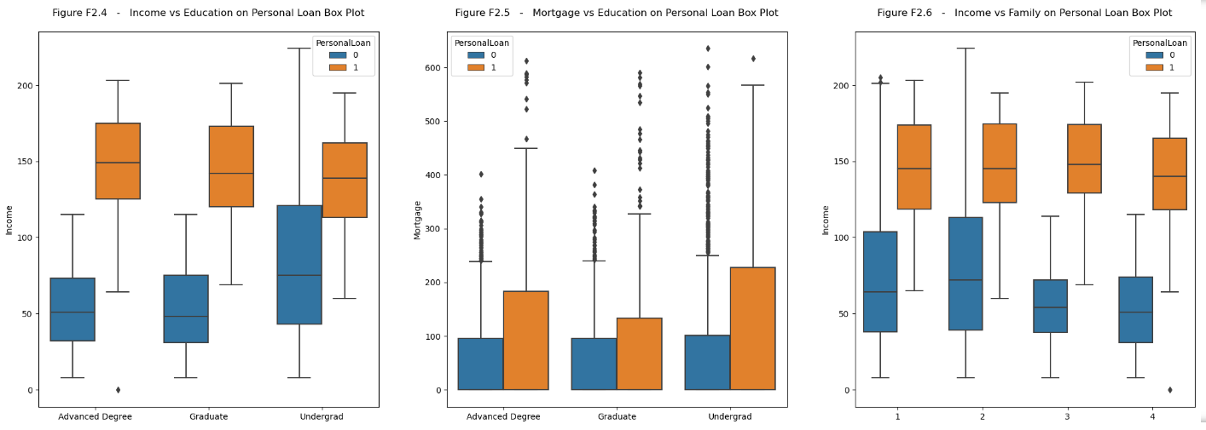
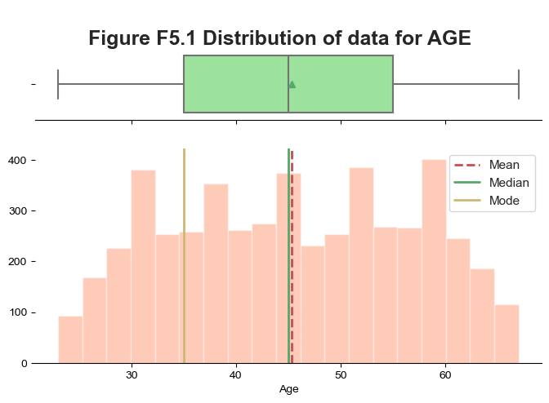
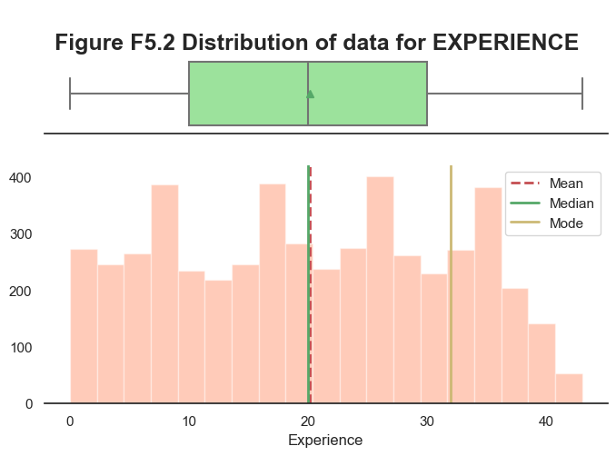
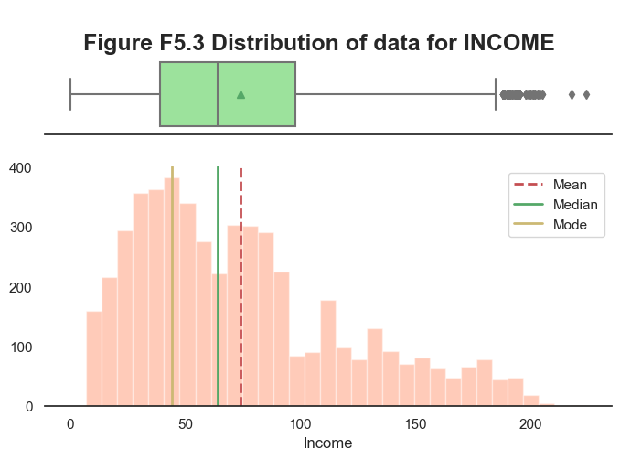
Visualization - I
I
Some of the Plots

Slide 11
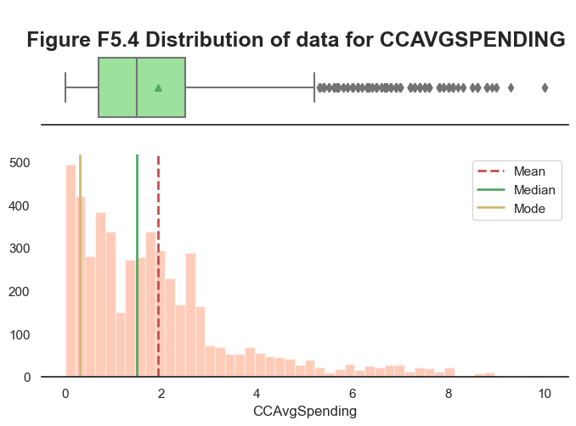
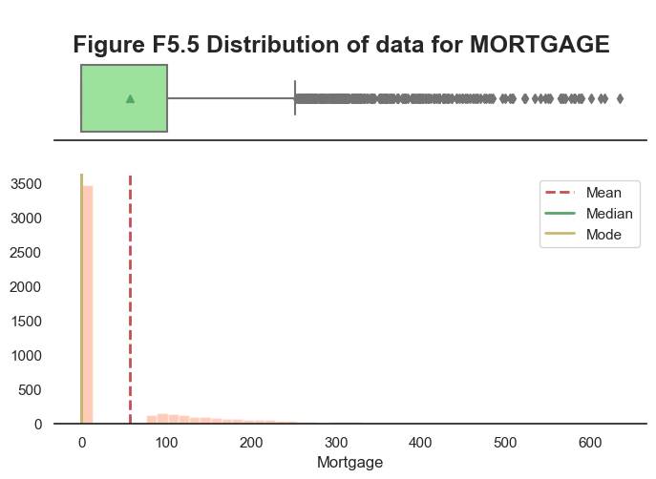
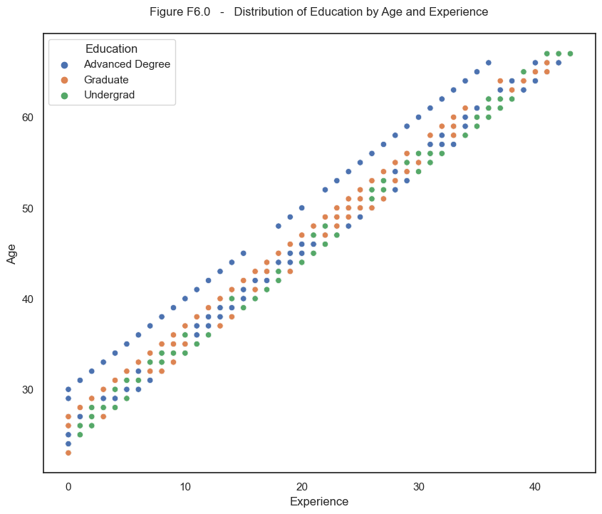
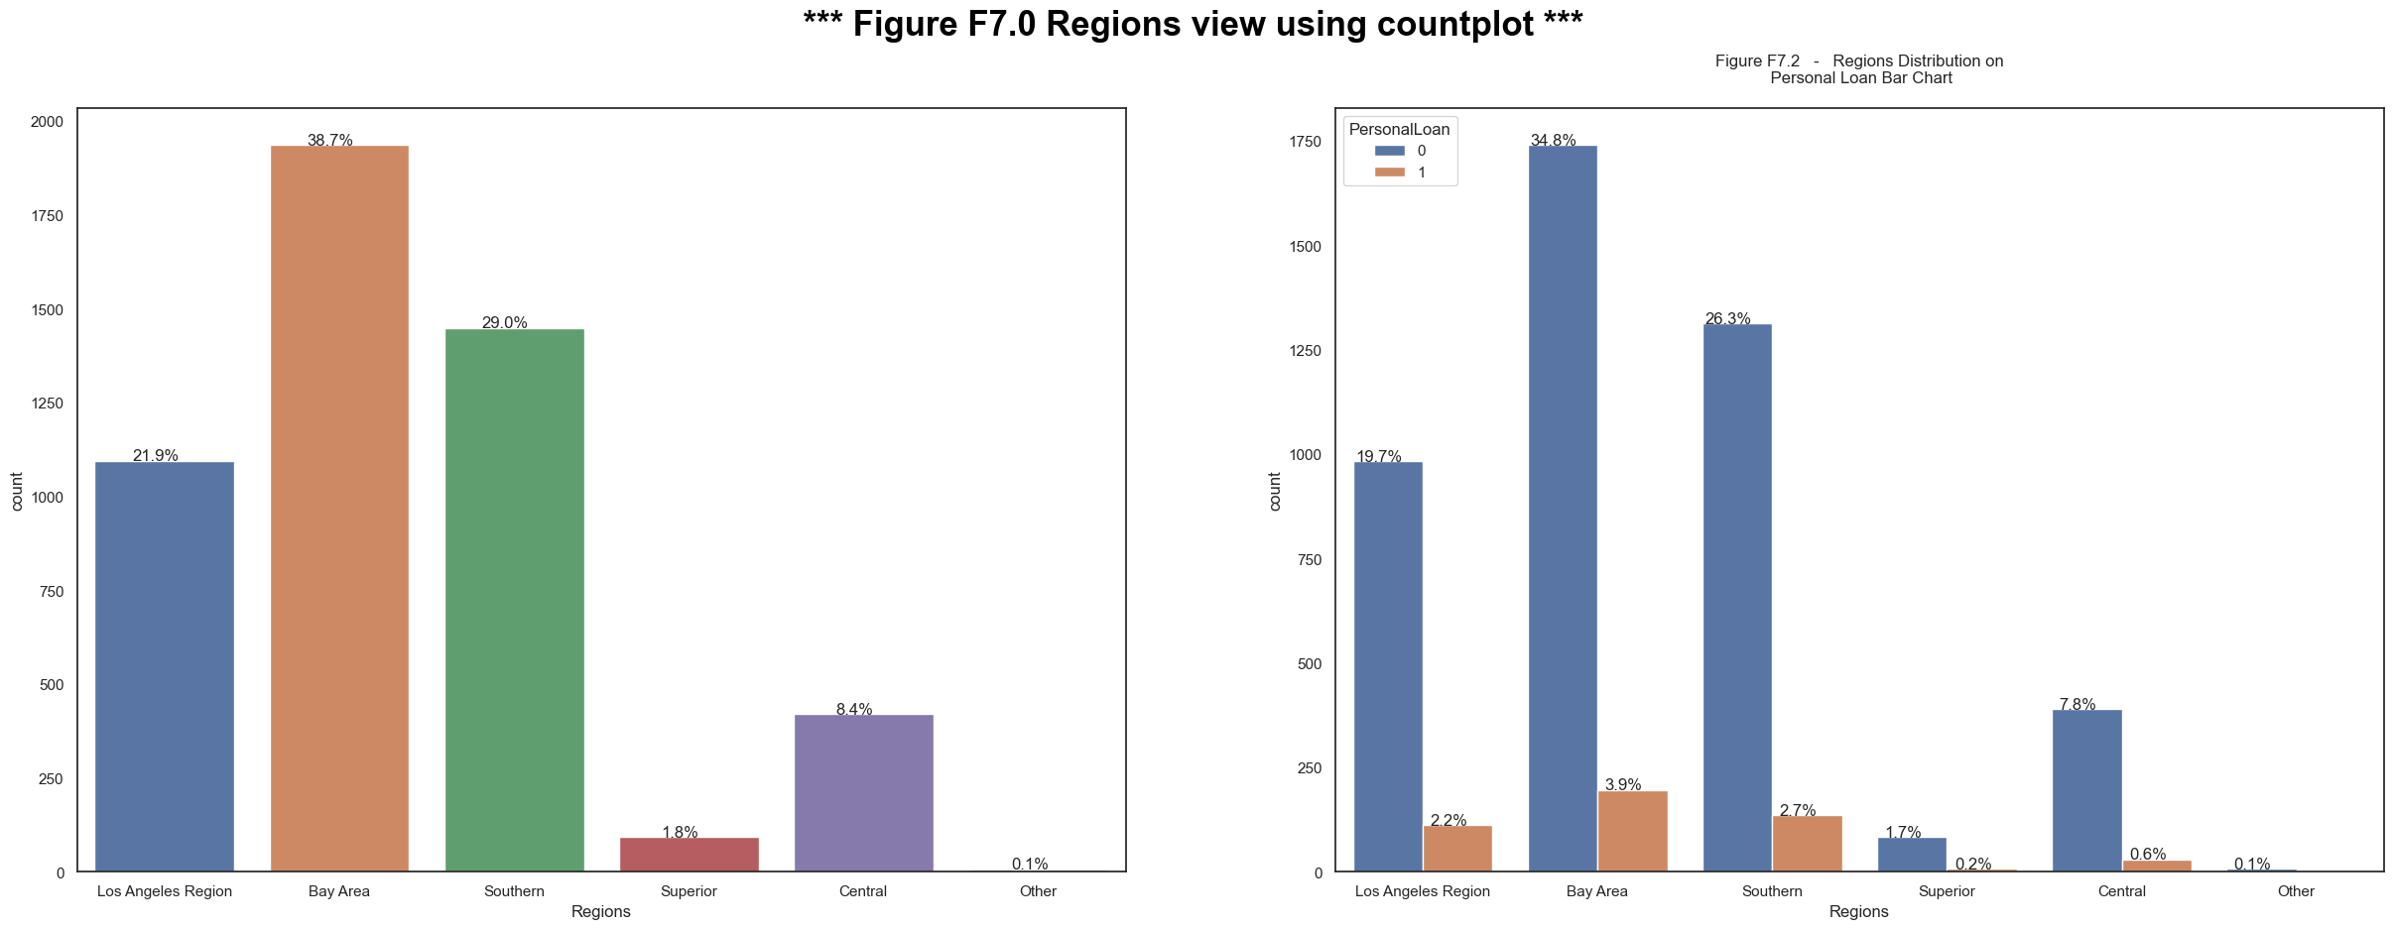
Visualization - II
I
Some of the Plots - Continue

Slide 12
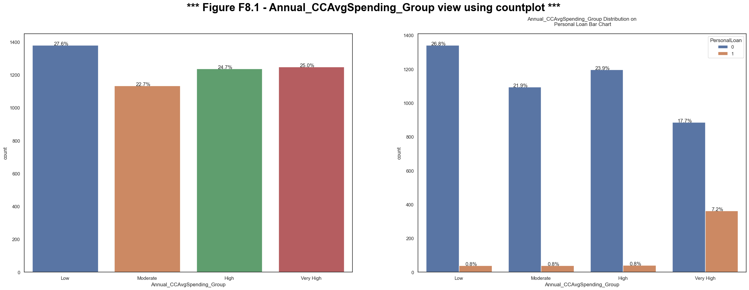
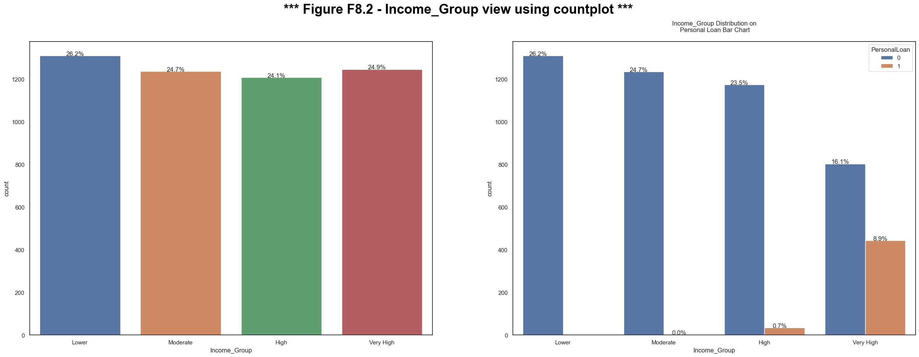
Visualization - III
I
Some of the Plots - Continue

Slide 13
EDA Insights - I
I
EDA Insights
Experience and Age gives a high positive correlation which implies, as Experience increases Age also increases in Figure F6.0 and Experience and Age has positive correlation value of 0.99 in correlation plot.
Age - This feature is almost normally distributed where majority of customers are between age 23 to 67 years. Also we can see median is almost equal to mean in Figure F5.1. And Age_Group - All the 4 groups have almost similar distribution in with loan and without loan in dataset in Figure F8.3.
Experience - This feature is also almost normally distributed and mean is also almost equal to median in Figure F5.2. But there are some negative values present which we have treated during cleaning process.
We can see for Income , CCAvgSpending , Mortgage distribution is left skewed (Required to perform transformation to convert into to normal distribution) in Figure F5.3, F5.4, F5.5 respectively.
Income - This mean is greater than median in Figure F5.4. Also customers with higher income are more likely to take up the personal loan in Figure F8.2 for Income_Group and Income and CCAvgSpending is positively correlated with a correlation value of 0.58
Postal Code - Mapped each postal code to City using zipcodes library and mapped the city to regions while data processing. Regions - Customers are more from Bay Area with 38.7% and even they are the one in all regions are likely to go for personal loan with 3.9% in Figure F7.0.

Slide 14
EDA Insights - II
I
EDA Insights Continue
From the above chart Figure F2.4, we can see that, the customers whose education vs personal loan distribution Education level is 1 (undergrad), having more income than the others customers whose education level is more! The customers who has taken the Personal Loan have almost the same Income levels. Also Customers with no Personal Loan, having education levels 2 and 3, also have same level of income.
CCAvgSpending - For this, Annual_CCAvgSpending - CCAvgSpending * 12 (To make it consistence with anuul income). Annual_CCAvgSpending_Group* - Also customers with higher anual credit card spending are more likely to take up the personal loan in Figure F8.1.
Mortage - we can see that the customers have mortgage minimum of 0k and the maximum value is 635K in Figure F2.5 and in dataset description.
Family Size - From the above view Figure F2.6, we can find the insights that Families with income less than 100K are less likely to take loan, than families with high income as well as in Figure F1.0, Family with member 4 are more likely to take personal loan.
Majority is the customers does not have Investment Account and majority customer have Personal loan who doesn't have have Investment Account in Figure F1.0
Many Customers without Deposit Account, have Personal loan Figure F1.0.
Customers with Internet Banking are more in taking loan in Figure F3.4
Customers with personal loan has higher Mortage than customer without personal loan in Figure F3.4

Slide 15
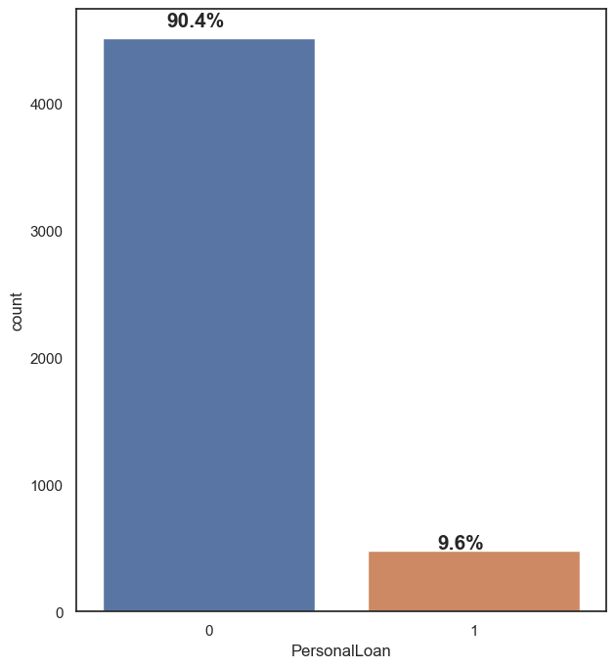

Modeling and Comparisons
I
Modeling
Imbalance Dataset described below:
This has 90.4% of customers who doesn’t opted the personal loan in last campaign and 9.6% customer took. This observation convey that we have highly imbalance data set for modelling. If our all prediction will be wrong then still the model accuracy will be 90.4% which is baseline model accuracy.
To handle this, we will be using stratification. Stratification is an important step in splitting imbalanced datasets into training and test sets. Stratification ensures that the proportion of each class remains the same across both the training and test sets. This is important as it allows for a more accurate evaluation of the model, avoiding bias due to a disproportion of one class being over-represented in either dataset. Stratified sampling also ensures that any trends or correlations among different classes that exist within the overall dataset are preserved after splitting into training and test datasets:
Split the data into Training and Test dataset with 80-20 rule using stratification
Before Proceeding with Modeling, we have dropped some columns like ID, Postal Code, Income Group, CCAvgSpending, Annual CCAvgSpending
Using Multi-Colinearlity Check using VIF ( > 10) and dropped Age from Dataset as Age and Experience has VIF of ~49.

Slide 16
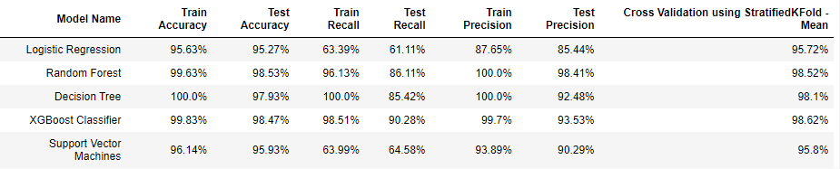
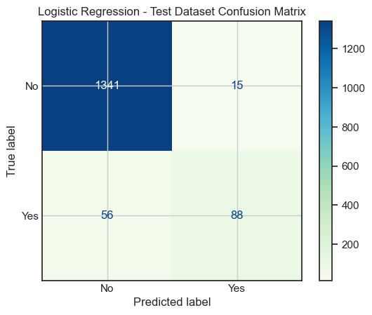
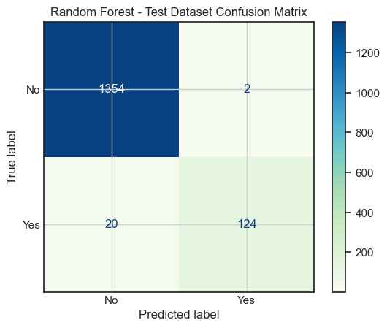


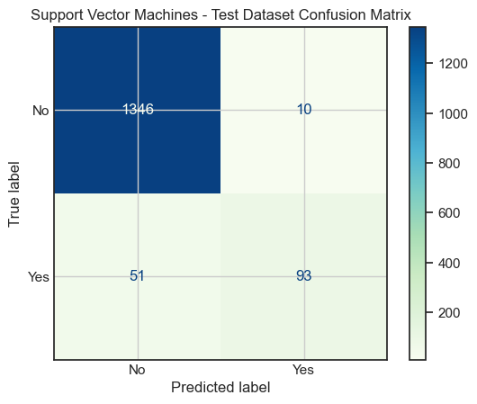
Modeling and Comparisons
I
Modeling - Continue
We are using 5 different model to see which give the better score.
Logistic Regression
Random Forest
Decision Tree
XGBoost Classifier
Support Vector Machines
Have created a class which has all the methods, so that we can reuse.
Using Cross Validation (StratifiedKFold) to validate the model score (it is similar like stratify but it will be done multiple times)
Model Comparison Below : Random Forest, Decision Tree and XGBoost are giving ~98% (mean accuracy using KF) but the recall if XGBoost is much better than all these three. So we will be considering XGBoost.

